Slide 1

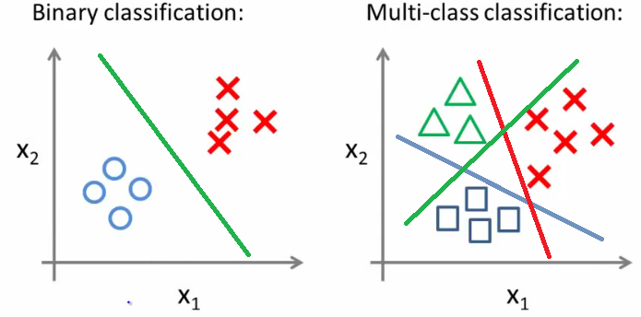
Logistic Regression

Slide 2




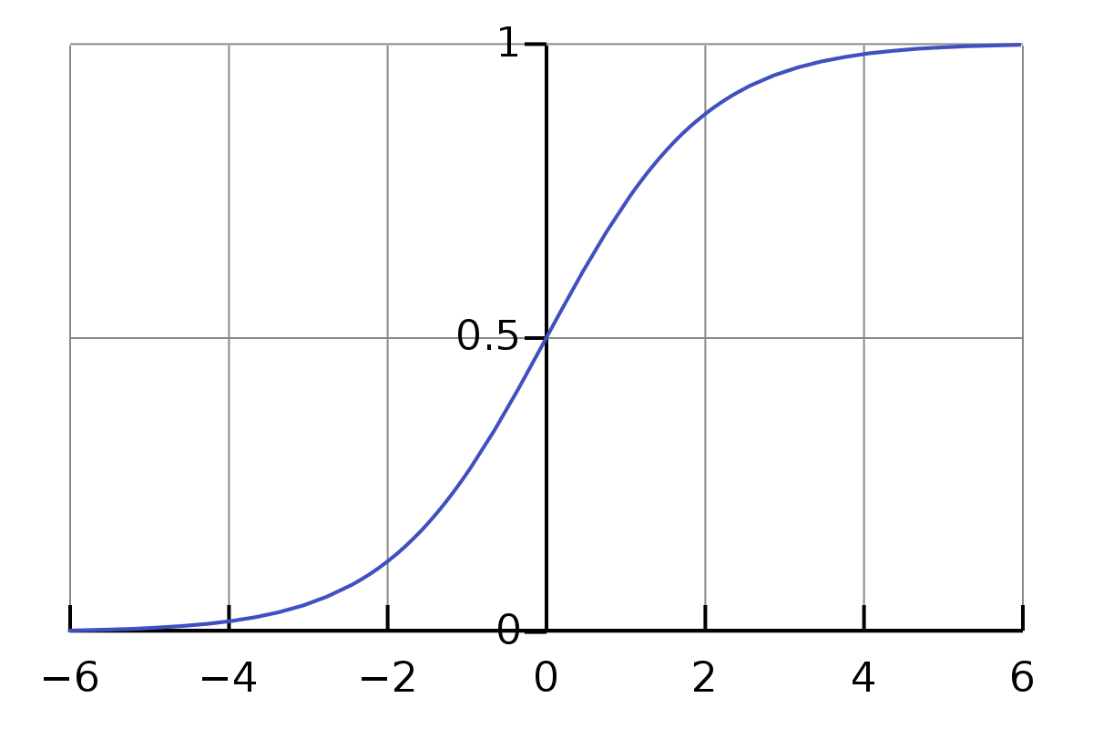
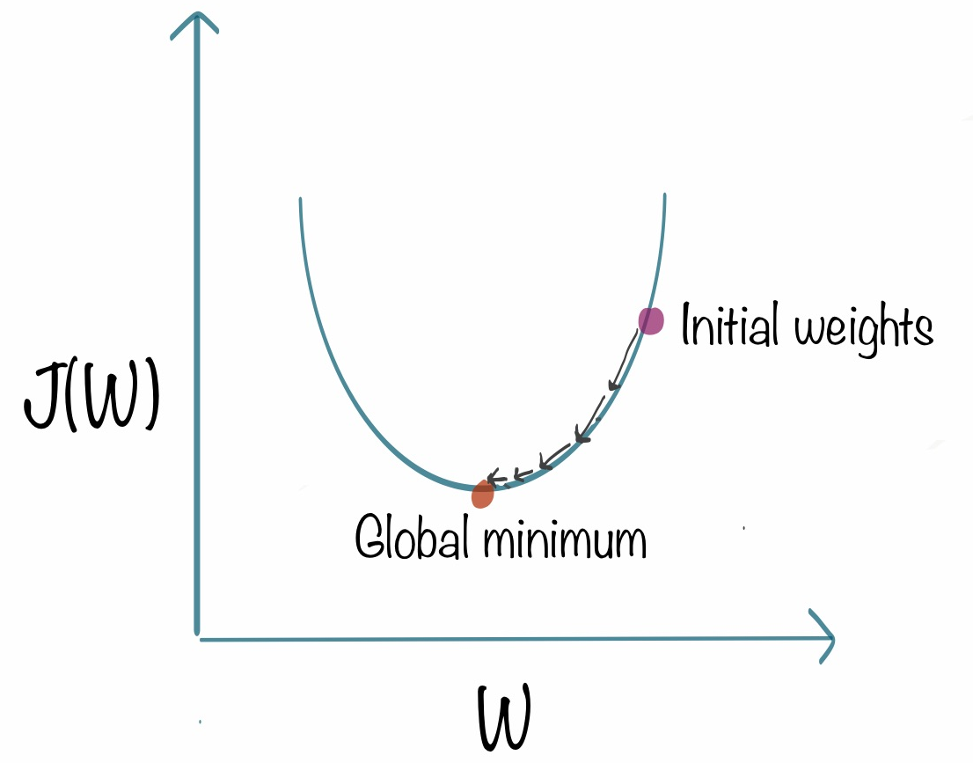
Linear Regression
Sigmoid
Hypothesis :
Optimizer used :

Slide 3
Downsides in Logistic Regression if we use the same hypothesis function as of Linear Regression
Tip
1 ≥ h(x) ≥ 0
h(x) = P(Y|X)
Y is Binary(0 or 1)

Slide 4
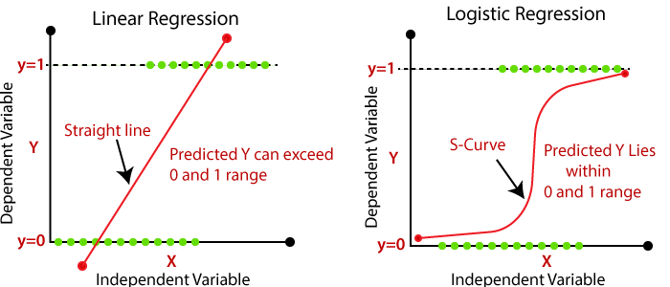
Downsides in Logistic Regression if we use the same hypothesis function as of Linear Regression
Tip
1 ≥ h(x) ≥ 0
h(x) = P(Y|X)
Y is Binary(0 or 1)

Slide 5
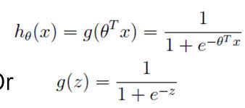
Logistic Regression
Hypothesis :
Cost Function ??
Goal : Minimize Cost Function
Hypothesis:
Tip
Cost Function is a function that measures the performance of a Machine Learning model for given data.

Slide 6
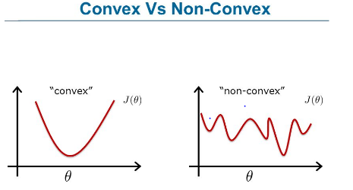
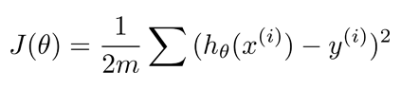

Linear Regression
Convex Function
Non - Convex Function
By the end of this section, your audience should be able to visualize:
Cost function :
What if we use the same Cost function?
Tip
h(X) is a complex function
Non-convex don't reach minima easily

Slide 7
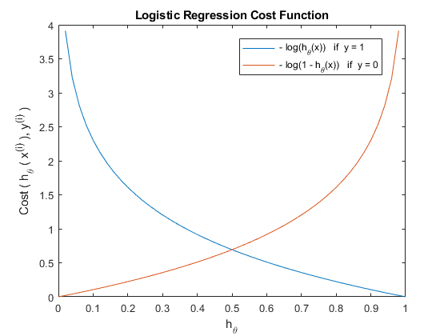
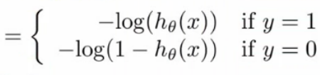
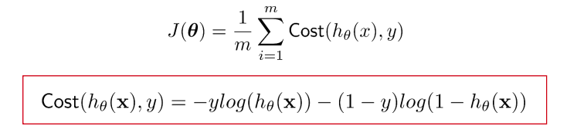
Logistic Regression
Cost Function

Slide 8
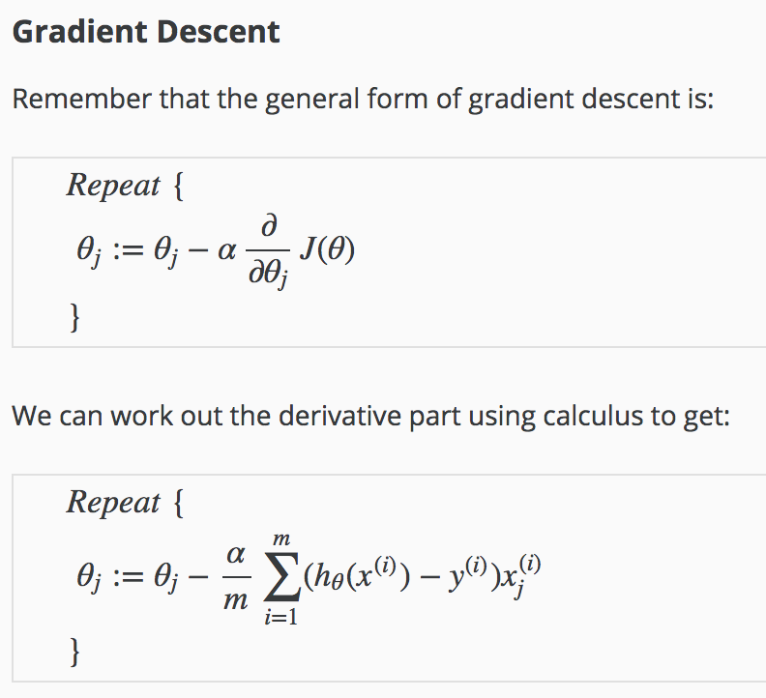

Slide 9
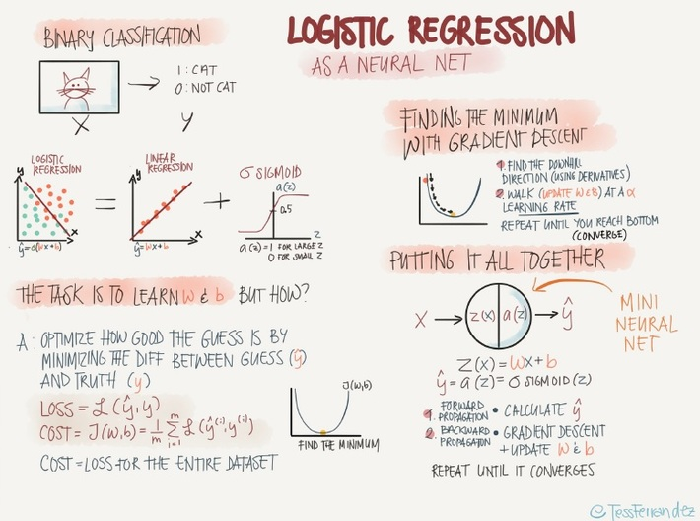

Slide 10
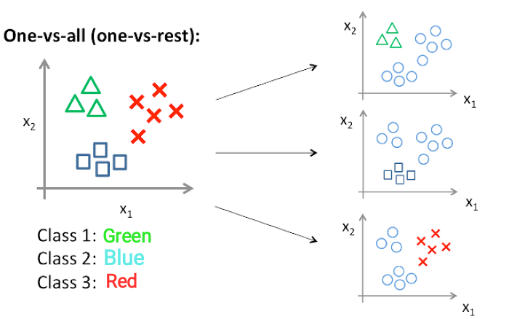

Slide 11
References for images:
andrew ng course

